Slide 1
AWS – DynamoDB
April 2016

Slide 2
Version Sheet: MANDATORY (hidden in ‘slide show’ mode)
Version | Changes | Author
001 | Redesign | Rohan Salvi

Slide 3
Note to the SME:
Note to the SME:
This is a temporary slide and will not be part of the final upload at all. It is to help the SME understand how we will communicate changes to them.
Please read before you begin reviewing this module as SME
Dark Red box with white text
Note to the SME
The SME must provide missing info.
Amber box with black text
Note to the SME
The SME must validate the re-design/ the modification/ addition.
To Review and Navigate the comments in the presentation Click on the “Review” Tab and then Click “Next” to review all the comments . Also you can add your comments using the “New comment” button
The comments in the review section have also been updated in a green textbox with black text.
.

Slide 4
Ground Rules for Face-to-face Classrooms
Everyone participates
Respect individual opinions and diversities
Be open and honest
Give headlines, be concise
One speaker at a time
Make language a non-issue
Stick to time contracts
Seek first to understand, and then to be understood
Clean desk / room policy
No mobile phone,
No computer (except for surveys, polls etc)
Clients & Leadership are often around, please remember that
Maintain a spirit of fun and enthusiasm
Notes:
Best to print on an A3 sheet and display in class. The idea is to co-create, to connect to learn, to do-learn-do (knowing is not enough, the real purpose is to apply what we learn on the job). It would also be great to have the class share their learning with their teams. You are the facilitator, you will help all share knowledge and learn new concepts or skills, there will be no lectures, everyone is a teacher.

Slide 5

Ground Rules for Virtual Classrooms
Wait for others to finish speaking before you speak
Each time you speak, state your name
Build on others’ ideas and thoughts
Disagreeing is OK –with respect and courtesy
Participate actively in each session
Share experiences and best practices
Bring up challenges, ask questions
Discuss successes
Respond to whiteboards, polls, quizzes, chat boxes
Hang up if you need to take an urgent phone call, don’t put this call on hold
As a best practice…be just a few minutes early!
Communicate professionally with others
Mute when you’re not speaking
Be on time for each virtual session
Notes:
Show this slide and hide the one for onsite classrooms, if this is a virtual session.
ONLY for Virtual classrooms

Slide 6
Module at a Glance
SME to provide the details required in the table.
Target Audience:
Course Level: | Basic
Duration (in hours): | 30 mins
Pre-requisites, if any: | NA
Post-requisites, if any: | Submit Session Feedback
Relevant Certifications: | None

Slide 7
Introductions (for Virtual Classrooms)
SME to provide the photos and names of the facilitators.
Business Photo
Business Photo
Facilitator
Name
Role
Moderator
Name
Role
Notes:
Add pics and Capgemini roles for the Facilitator and moderator. Establish their credibility, what qualifies them to facilitate this session.

Slide 8
Course Map
What is Relational vs Non Relational?
1
Web Identity Providers
What are Dynamodb basics ?
2
DynamoDB Indexes
3
DynamoDB streams
4
Dynamodb Pricing
5
Conditional Writes & Atomic Counters
6

Slide 9


Module Objectives
Note to the SME : Please provide the module Objectives or validate the partially updated content
What you will learn
At the end of this module, you will learn:
What is DynamoDB
What you will be able to do
At the end of this module, you be able to:
Explain what is Relational vs. Non relational
DynamoDB ,Facts, Basics , Pricing
Understand DynamoDB Indexes , DynamoDb Streams,
Describe S3 Pricing , Query Vs Scan , Provisioned Throughput
Describe Web Identity Providers ,Conditional Writes ,Atomic Counters

Slide 10

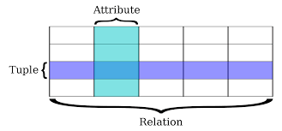
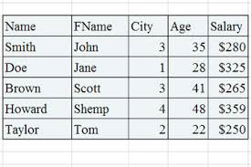
Relational Databases
Database
Table

Slide 11






Relational Database types

Slide 12
Non Relational Database
Database
Collection = Table
Document = Row
Key Value Pairs = Fields

Slide 13
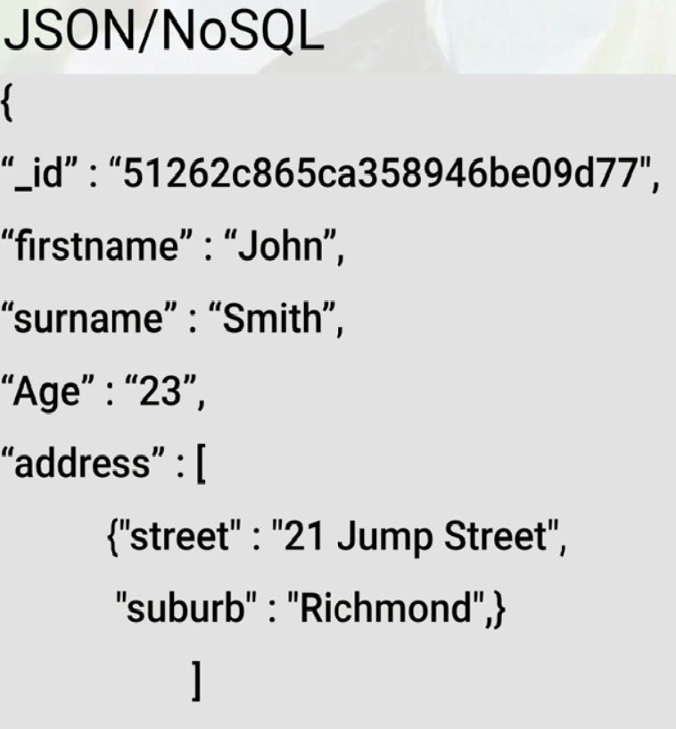
JSON - NOSQL

Slide 14
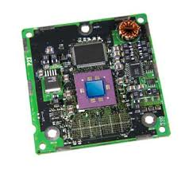


Elastic Cache
deploy
Elastic Cache
operate
Scale

Slide 15

DMS – Data Migration Service
Production to AWS

Slide 16
Databases - Summary
RDS - OLTP
SQL
MySQL
PostgreSQL
Oracle
Aurora
MariaDB
DynamoDB – NOSQL
RedShift – OLAP
ElasticCache – In Memory Caching
Memcached
Redis

Slide 17
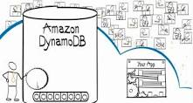
What is DynamoDB ?
Fast
Flexible
NoSQL database Service
Fully managed Database
Supports both document and key value data models
Flexible data model & reliable performance
IOT
Ad-tech
Mobile
Web
Gaming

Slide 18


Facts about DynamoDB
Stored on SSD Storage
Spread across 3 geographically distinct data centers

Slide 19
Facts About DynamoDb
Eventual Consistent Reads
Consistency is reached across all copies within a second .
Repeating a read after a short time should return the updated data .
Strongly Consistent Reads
Returns a result that reflects all writes that received a successful response prior to the read .

Slide 20
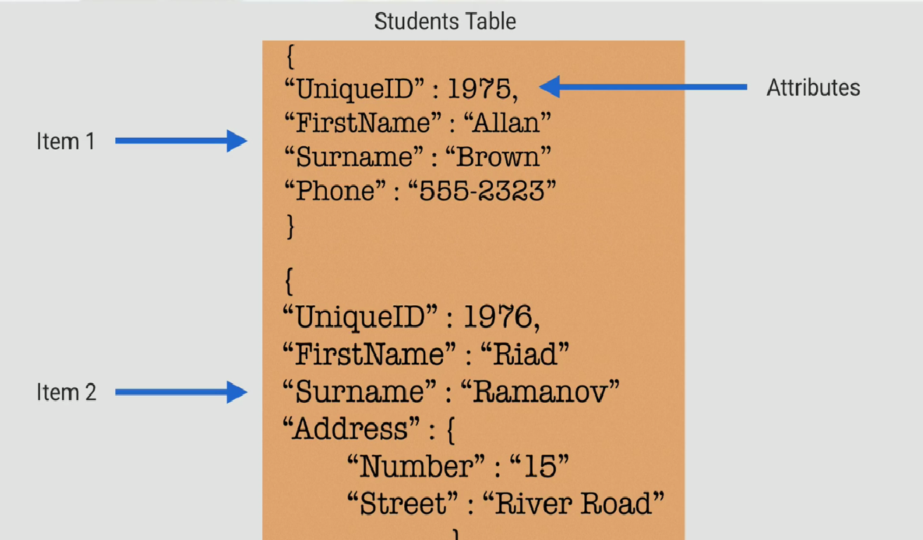
DynamoDB - Basics

Slide 21
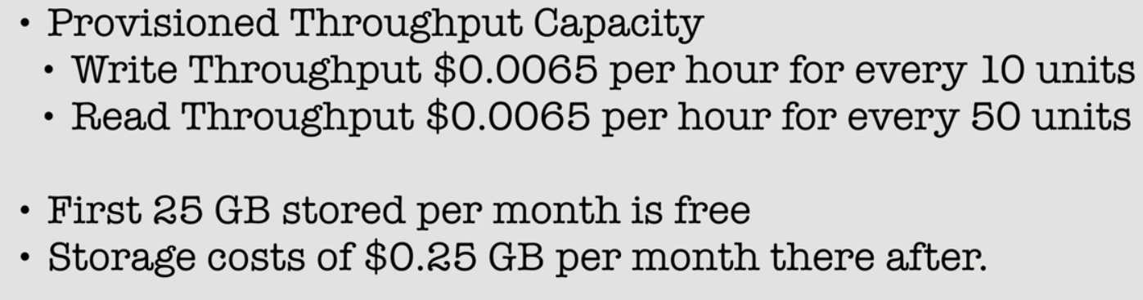
Pricing

Slide 22

Pricing Example
1 million writes per day = 1,000,000(writes)/24(hours)/60(minutes)/60(seconds)= 11.6 writes per second .

Slide 23
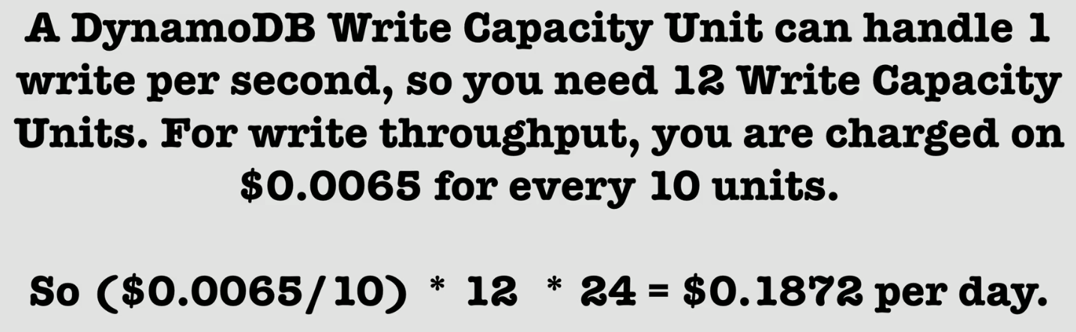
Pricing Example

Slide 24
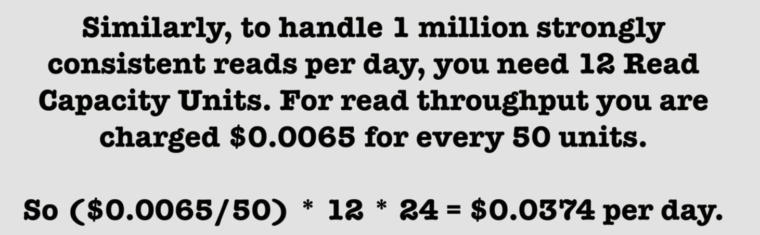
Pricing Example

Slide 25
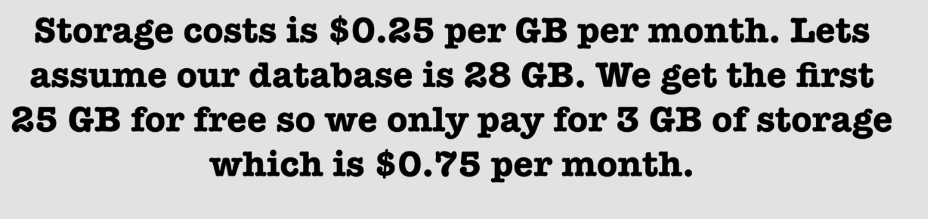
Pricing Example

Slide 26
DynamoDB Indexes
DYNAMODB INDEXES

Slide 27
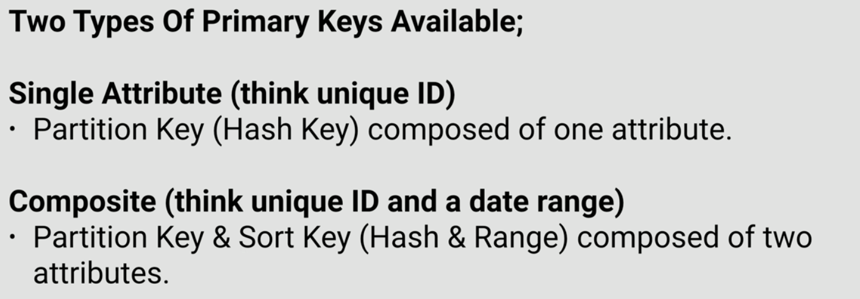
Dynamodb Indexes

Slide 28
Dynamodb Primary Keys
Partition Key
Dynamodb uses partition key’s value as input to an internal hash function .
The output from hash function determines the partition .
No two items in the table can have the same partition key value
Partition Key & Sort Key
Dynamodb uses partition key’s value as input to an internal hash function .
The output from hash function determines the partition .
Two items in the table can have the same partition key but they must have a different sort key .
All items in the same partition key are stored in the sorted order by sort key value.

Slide 29
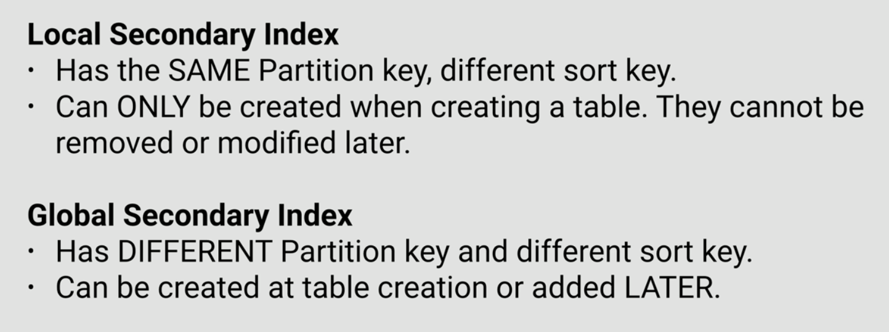
Dynamodb Indexes

Slide 30
DynamoDB Streams
Used to capture any kind of modification of the Dynamodb tables

Slide 31
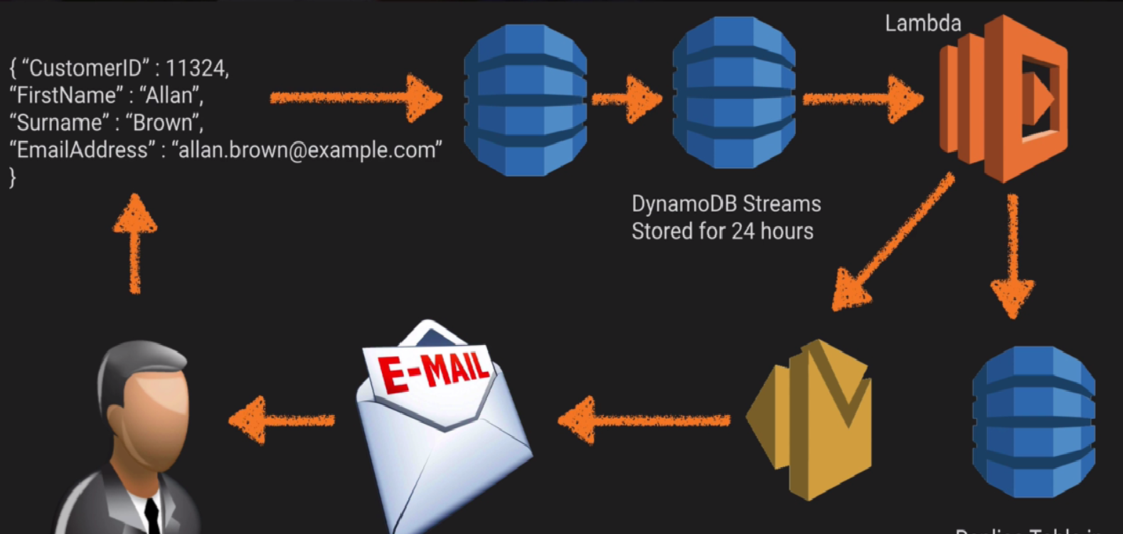
DynamoDB Streams

Slide 32
Query
Query Operation finds items in a table using only primary key attribute values .
Provide a partition attribute name and distinct value .
Optionally provide a sort key attribute name .
By default Query returns all of the data attributes for items with specified primary key
Use projection Expression parameter Query returns only some of the attributes

Slide 33
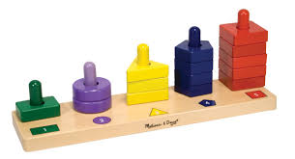

Query
By Default , Sort order is Ascending
Set the parameter to
ScanIndexForward

Slide 34

Scan
A scan operation examines every time in the table
Returns all attributes for every item

Slide 35
Query VS Scan
Query is more efficient than a scan operation
For quicker response times ,use BatchGetItem API’s

Slide 36
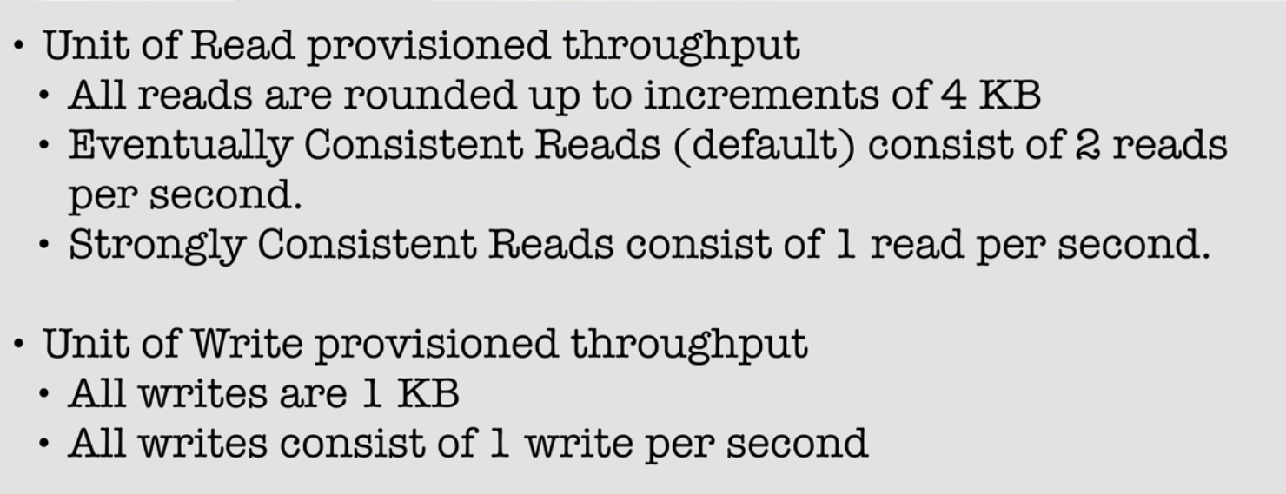
Provisioned Throughput

Slide 37
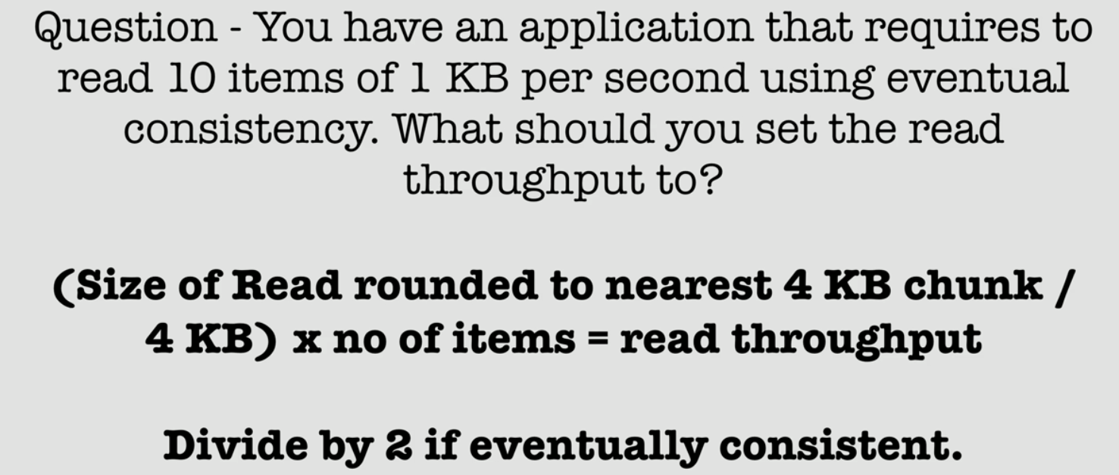
Magic Formula

Slide 38
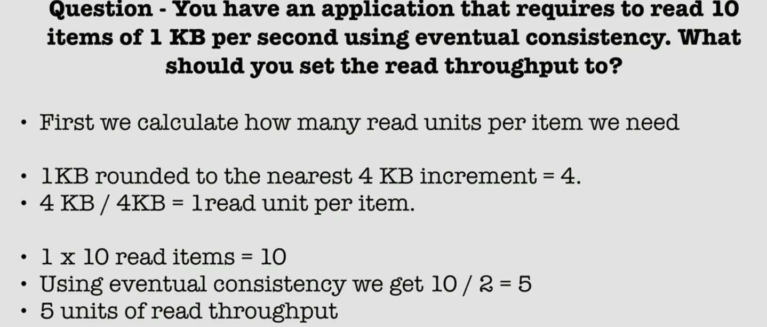
Example 1

Slide 39
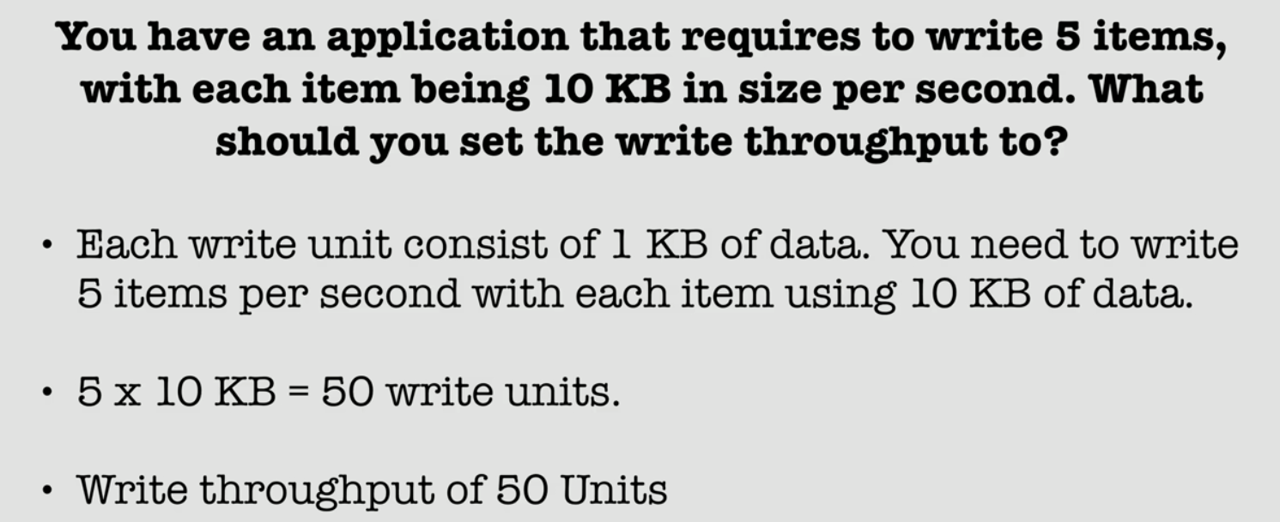
Example 2

Slide 40
Web Identity Providers with DynamoDB
Using Web Identity Providers with DynamoDB

Slide 41




Web Identity Providers
Authenticate Users using Web Identity Providers
Authenticate is done using AssumeRoleWithWebIdentity API

Slide 42
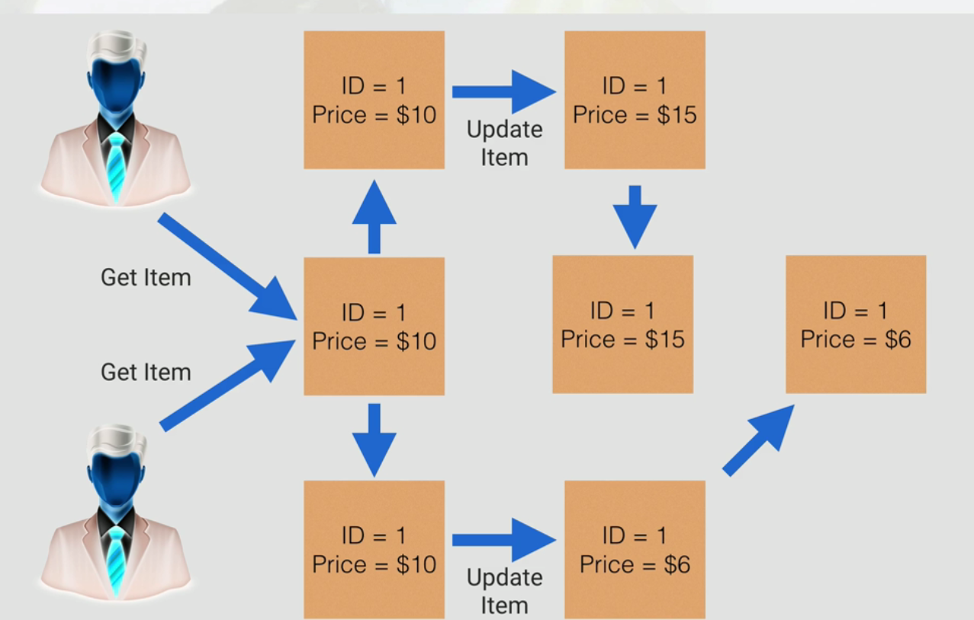
Conditional Writes

Slide 43
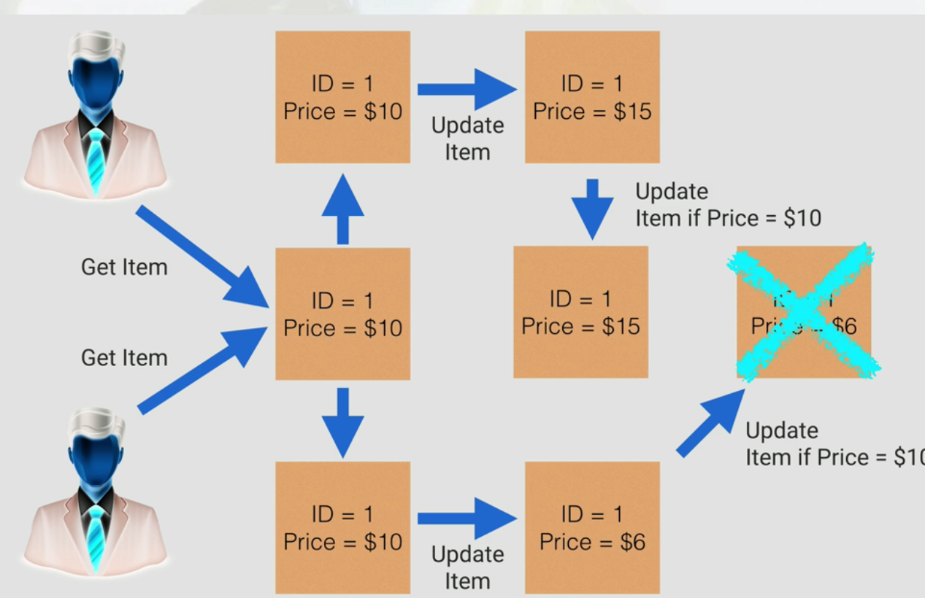
Conditional Writes

Slide 44
Conditional Writes
Conditional Writes are idempotent .
We can send the same conditional write request multiple times , but it will have no further effect on the item after the first time Dynamodb performs the specified update .
Banking Application – More applicable to go for Conditional Writes

Slide 45
Atomic Counters
Atomic Counter updates are not idempotent .
This means that the counter will increment each time you call UpdateItem.
Web application – maintain a counter per visitor

Slide 46

Batch Operations
Multiple items can be read using
BatchGetItem

Slide 47
Summary
Learnt what is Relational vs Non relational databases
Dynamodb Basics, Facts
Dynamodb Indexes , Streams
Dynamodb Pricing
Conditional Writes & Atomic Counters
Web Identity Providers
Batch Operations

